Slide 1

Video Presentation
Gia Bao Hoang – a1814824
Notes:
Hello, I am Bao, this is my video presentation for the Internship course

Slide 2
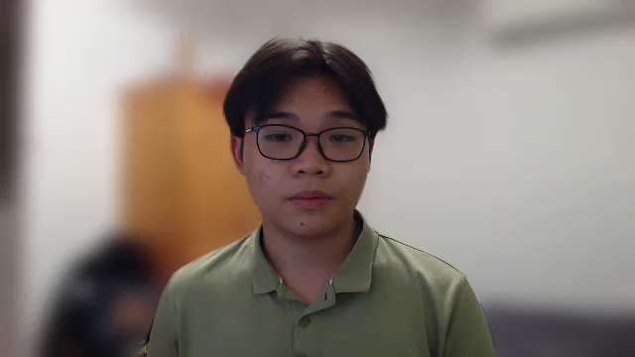
Introduction
A third-year Computer Science student. Currently working as an Engineer Intern at ElectraNet.
ElectraNet is a private company that operate South Australia’s high-voltage electricity transmission network.
My project is investigating imputation strategies for ElectraNet to employ when weather data is missing
Notes:
I am third-year computer science student.Currently I am working as an Engineer Intern at ElectraNet.
So, what is ElectraNet? We are a private company that operate South Australia’s high-voltage electricity transmission network. At ElectraNet, we focus on power people’s lives, connect people, and create a better future with energy and infrastructure solutions.
My main project is to investigate imputation strategies for ElectraNet to employ when weather data is missing.

Slide 3
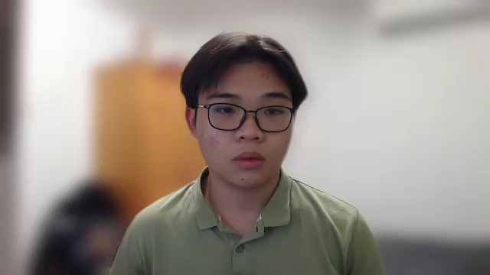
Things I’ll be doing
Working on the assigned project:
Develop a sound understanding of the causes of data missingness.
Investigate, and propose suitable data imputation techniques.
Propose data quality checks to identify and raise an alarm in real-time.
Using SQL and Python as tools for the project.
Finalize a written report and make a presentation for the project.
Notes:
The project can be divided into 3 major tasks:
Develop a sound understanding of the causes of data missingness in ElectraNet’s weather data
Investigate, and propose suitable data imputation techniques to appropriately recreate data that is missing or corrupted.
Propose data quality checks that can run on the weather data server to identify and raise an alarm in real-time where a given weather station is failing
In this project, I will use SQL to queries weather data from server, Python to visualize and explore the data as well as implement and validate imputation methods.
At the end of the project, I will draft and finalize a report on my work. This will be the base for my presentation of the result.

Slide 4
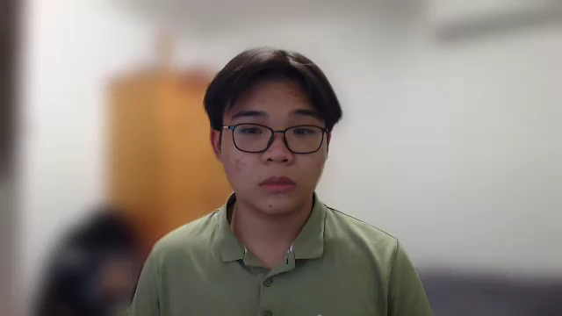
What I hope to get out of it?
Deliver the desired outcomes of the project. Could potentially extend the scope of the project.
Practice the skills I learned from the University’s courses as well as broaden my knowledge in data science.
Expand my connections and polish my soft skills. Learn from the best in their field.
Notes:
This internship is an amazing opportunity for me to develop my technical skills, grow my soft skills, and gain valuable experience working in the professional environment if I can make the most out of it.
My focus would be to achieve the desired outcomes for the project, or even better, I could extend the scope of this project to address some potential problems with weather data at ElectraNet. In addition, I can practice what I have learned from the university courses as well as broaden my knowledge in data science.
Aside from that, this is a good chance to expand my professional network. Furthermore, I can grow my communication and teamwork skills while working with my supervisors and colleagues. I can also learn from some career tips and mindset from some of the very best in the industry.

Slide 5
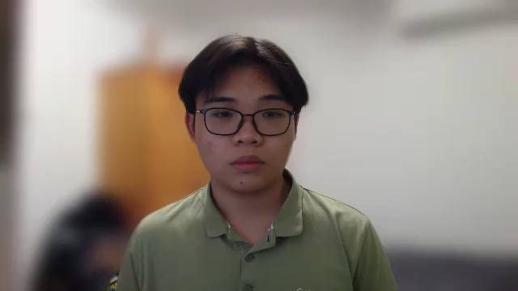
Thank you for listening!
Gia Bao Hoang – a1814824
Notes:
And that is the end of my video presentation. Thank you for listening!

